Slide 1

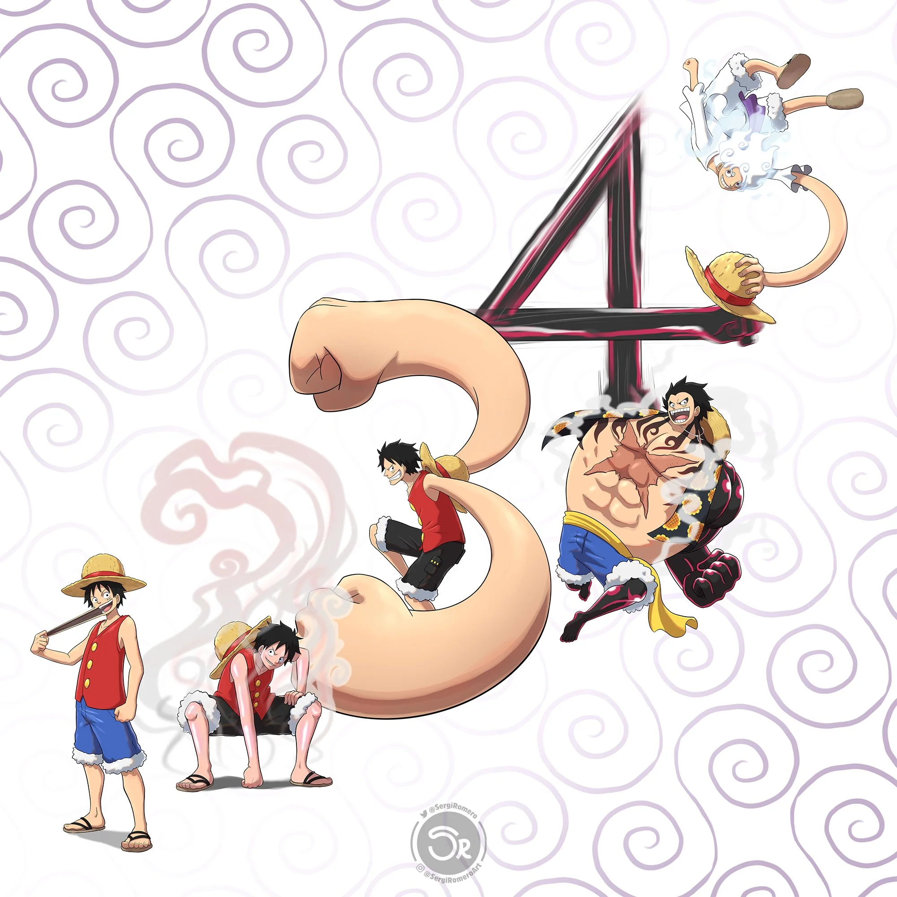
Manga Luffy Gears

Slide 2
Manga Luffy Gears

Slide 3
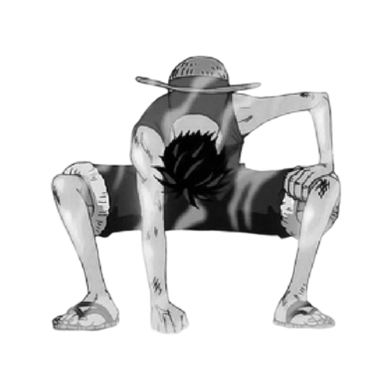
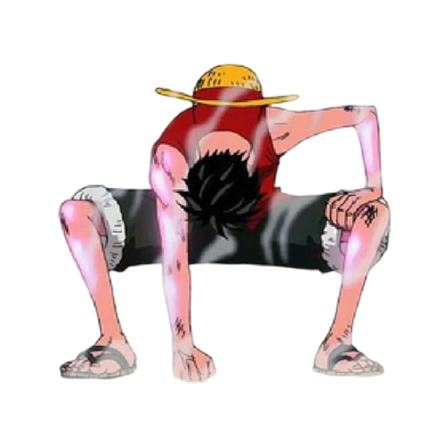

Straw Hat, is that all you've got? You weren't up to expectations.
"How will Luffy rise from this situation? Is this the end? His opponent this time isn’t like the previous ones."
Gear Second is one of Luffy's early power-ups in One Piece, first introduced during his fight with Blueno in Enies Lobby. By pumping his blood faster through his body using his rubber abilities, Luffy increases his speed, strength, and reflexes. This technique gives him a steam-like aura, and his movements become almost too fast to track. Gear Second allows Luffy to take on much stronger opponents who would have overwhelmed him otherwise.
However, the technique takes a toll on his body, as it requires a lot of energy and initially shortens his lifespan. Despite its risks, Luffy masters it over time and uses it more efficiently in later arcs. Gear Second represents Luffy’s determination to grow stronger for the sake of his crew, and it marks a key moment in his journey as a fighter.
The fact is, Luffy won’t go down easily—he’ll rise again now!

Slide 4
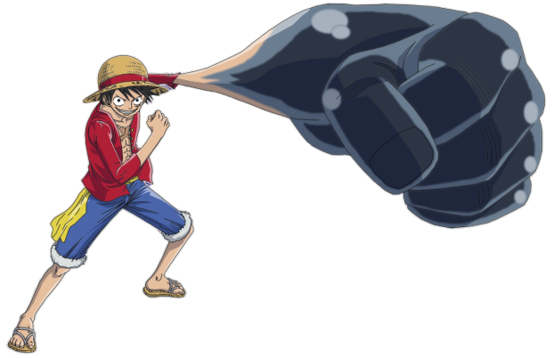
Gear Third is one of Luffy's most powerful techniques in One Piece, first introduced during the Enies Lobby arc. In this form, Luffy inflates his bones by blowing air into them, causing his limbs to grow significantly larger. This technique allows him to deliver devastating attacks with immense power. For example, his signature move, "Gomu Gomu no Elephant Gun," showcases the sheer force he can generate.
While in Gear Third, Luffy becomes slower due to the added weight of his inflated limbs, making him more vulnerable during combat. However, he compensates for this by using the technique strategically, often surprising his opponents. After using Gear Third, Luffy temporarily shrinks down and becomes exhausted, which adds a risk factor to its usage. Despite this drawback, Gear Third is a crucial part of Luffy's arsenal, allowing him to face formidable foes. It demonstrates his creativity and adaptability as a fighter, reinforcing his determination to protect his friends and achieve his dream of becoming the Pirate King.
"Hahaha, what do you think if I show you a new technique that I think I will call Gear Third“
"Get ready for what's about to happen, as the excitement starts now!"

Slide 5

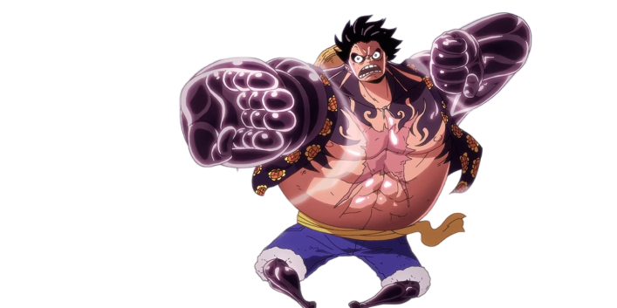
Gear Fourth is one of Luffy's most iconic transformations in One Piece, first introduced during his battle against Doflamingo in Dressrosa. In this form, Luffy inflates his muscles with air, giving him a massive and muscular appearance. This technique significantly enhances his strength, speed, and agility, allowing him to deliver powerful blows and dodge attacks effectively.Luffy has different forms within Gear Fourth, such as Boundman, Tankman, and Snake Man, each offering unique abilities and fighting styles. Boundman is characterized by increased power and speed, while Tankman focuses on defense and counterattacks. Snake Man, on the other hand, emphasizes rapid, flexible movements, allowing Luffy to strike from various angles.Despite its immense power, Gear Fourth has its drawbacks. Luffy can only maintain this form for a limited time due to the high energy consumption, and he becomes exhausted afterward. Additionally, the use of Gear Fourth requires Luffy to be strategic in his battles, balancing offense and defense. This transformation showcases Luffy's creativity and determination, highlighting his growth as a fighter and his commitment to becoming the Pirate King.

Slide 6
Gear Fifth is Luffy's latest and most powerful transformation in One Piece, introduced during the Wano arc. Known as "Nika," this form embodies the mythical abilities of the Sun God, granting Luffy incredible powers and a whimsical fighting style. In Gear Fifth, Luffy’s appearance becomes more cartoonish, emphasizing his enhanced strength, speed, and resilience.
He can manipulate his environment, stretch his body further, and create unpredictable attacks, defying the laws of physics. However, maintaining this form consumes a significant amount of energy, and Luffy can only sustain it for a limited time. Once it ends, he experiences extreme fatigue, leaving him vulnerable. Despite these drawbacks, Gear Fifth represents Luffy's ultimate potential and determination to protect his friends while pursuing his dream of becoming the Pirate King.

Slide 7
